Slide 1
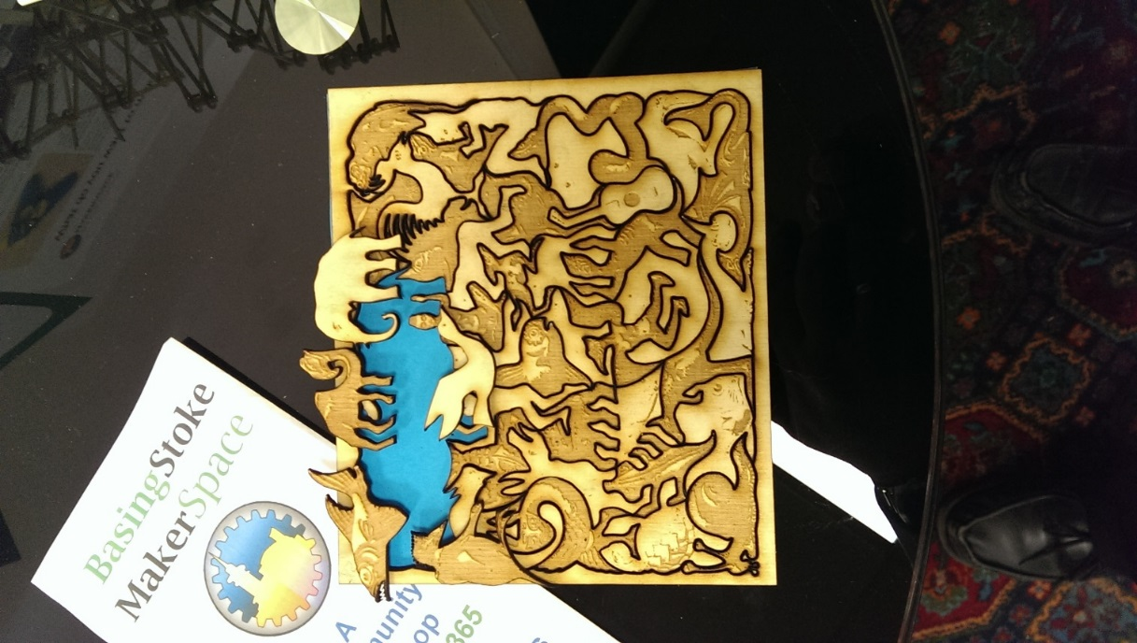

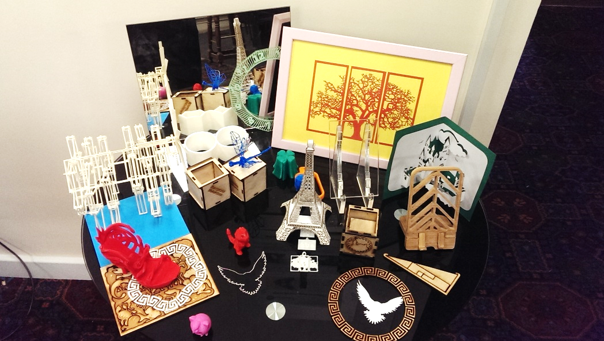
Basingstoke MakerSpace
Basingstoke MakerSpace
The MakerSpace is a not-for-profit community in Basingstoke who enjoy learning, making and collaborating together to build and create things in a friendly environment – whether that is a prototype of a product you’d like to design, a game, a sewing project, website design, or practising your artistic or crafting techniques.
Our members can help whether you are interested in learning to use the range of tools on offer, exploiting Raspberry Pi, Arduino or micro:bit, creating eye catching signs, building electronics, understanding the latest advances in technology or recreating your favourite characters in Cosplay.
Open Evenings 7pm – 9pm
Every Tuesday
at Maritime House
What you can create is only limited by your imagination. Our members have the expertise to guide even raw beginners through many different types of design and build. For the more knowledgeable sharing your enthusiasm with fellow experts is always inspiring.
Come along to see what the MakerSpace has to offer. Discuss your projects with experts and find out how our tools and experience can help.
Search for “Basingstoke Makerspace” on Google Maps
Opposite Jacob’s Yard Car Park
Maritime House
65 New Road
Basingstoke
RG21 7PW
Open to Members
24/7
Everybody Welcome

Slide 2
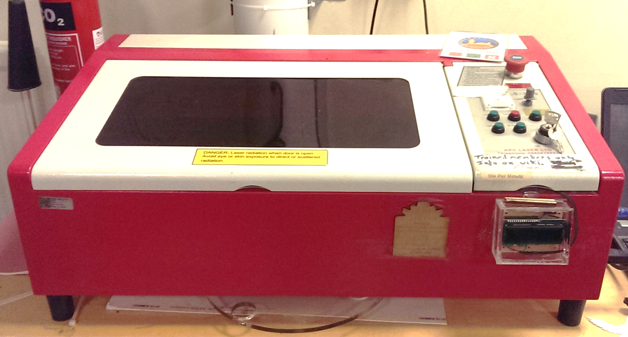
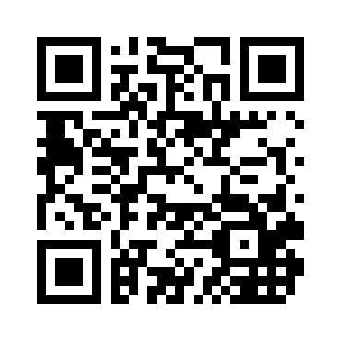
Basingstoke MakerSpace
Open Sessions
Every Tuesday evening, from 7pm to 9pm, there is an informal open session for members and potential members to get together.
Focused Project Tutorials
There are also frequent sessions focused on particular projects. Whether you want to fill your house with internet connected sensors, or make a Star Wars helmet, learning how from someone who’s already an expert will help.
Current Tools: Laser Cutter, 3D Printer, CNC Router, Vinyl Cutter, Woodworking & Metalworking tools
The space is equipped with the tools, you need to complete your projects. Some belong to the MakerSpace and others are on loan from our members. Experts are often available to help explain the optimal techniques to get the maximum benefit from each of the tools.
Current Activities: Raspberry Pi, Arduino, electronics, sewing, crafts, knitting and Linux
It doesn’t matter if you’ve never soldered an LED or if you have more than 25 years of Linux experience, you will find a welcoming community that can help you build anything. Outside formal sessions members are also available to discuss, debate and advise.
Come to a Tuesday meeting
//www.basingstokemakerspace.org.uk/
Tool Based Training
Members often require training to ensure the MakerSpace tools are used safely and efficiently. Sessions are available to ensure everyone gets the most out of all the tools available
Join up on the web site

